Slide 1
“Smart Automatic Petrol Pump System Based on RFID and ESP8266”
Sinhgad College of Engineering, Pune
Department of E&TC
B . E . E&TC - (Major – Project)
Group No: A64
By
Kunal Shivaji Chavan 404A035
Balaji Sarjerao Apet 404A014
Hrishikesh Bhanudas Barge 404A019
Guide: Prof. Prashant Dahale
2023-24, Sem: I

Slide 2
Contents
Introduction.
Motivation.
Literature survey.
Problem Statement & objective.
Block Diagram & Explanation.
Hardware and software required.
Component specification.
Advantages and disadvantages.
Applications.
Conclusion.
References.

Slide 3
Introduction
This project focus on design RFID based automated petrol pump to reduce human roles and develop an auto- led technique and to do the work serially by using RFID technology.
ATmega328 is an electronic circuit board that support you make shared objects by evaluating information from the real world, treating these information, and then getting action in the world suitably.
The UHF band RFID technology has been commonly accepted due to its large read range, and low-cost tags.
The components used in this project are ATMEGA328 Microcontroller, RFID tags, 20x4 LCD display, servo Motor ,DC motor, relay, 4x4 keypad, ultrasonic sensor , flame sensor, MQ-9gas sensor, RFID reader and ESP8266 module.

Slide 4



Motivation
Traditional fuel stations often suffer from long queues and inefficiencies due to manual payment processes and manual monitoring of fuel dispensing. This project aims to automate these processes, reducing wait times and enhancing overall efficiency.
Manual operations at petrol pumps can lead to errors in fuel quantity, payments, and change handling. Automation through RFID and ESP8266 technology can significantly reduce these errors, leading to a better customer experience.
The integration of sensors to detect potential hazards like fires or gas leaks improves the safety of both customers and station employees. It also enables immediate response and intervention in case of emergencies.
In an era of increasing digital payments, this project promotes cashless transactions by allowing users to pay with RFID cards, making the fueling process more convenient and secure.

Slide 5

Literature Survey
"Challenges to IoT-enabled predictive maintenance for industry 4.0”
The research paper titled "Challenges to IoT-enabled predictive maintenance for Industry 4.0"addresses the various obstacles and complexities associated with implementing Internet of Things (IoT)-enabled predictive maintenance strategies in the context of Industry 4.0.
Predictive maintenance involves using real-time data and analytics to anticipate when equipment or machinery might fail, allowing for proactive maintenance, reduced downtime, and cost savings.
"Petroleum pipeline monitoring using an internet of things (IoT) platform“
The paper introduces the concept of IoT and its relevance in the context of petroleum pipeline monitoring. It also discusses the growing importance of real-time data and remote monitoring in the oil and gas industry.
Given the critical nature of petroleum pipelines, security is of paramount importance. The paper also covers the security measures and encryption methods in place to protect the data and the infrastructure from cyber threats.

Slide 6
Problem Statement
Traditional methods of monitoring and operating petrol pumps at gas stations involve manual human intervention, leading to issues related to efficiency, accuracy, and cost-effectiveness.
The increasing number of vehicles, especially in countries like Iraq, has caused congestion at fuel stations, where drivers often face challenges such as making cash payments, dealing with change, and ensuring the accurate dispensing of fuel. Moreover, safety and security concerns, as well as the management of pump operations, present additional challenges.

Slide 7

Objective
To develop a system that automates the process of fuel dispensing to eliminate the need for manual intervention.
To implement RFID technology for user identification and payment processing to enable cashless transactions.
To enable users to monitor the quantity of fuel dispensed in real-time, providing transparency and accuracy.
To design the system to be energy-efficient and environmentally friendly, considering power consumption and emissions.

Slide 8
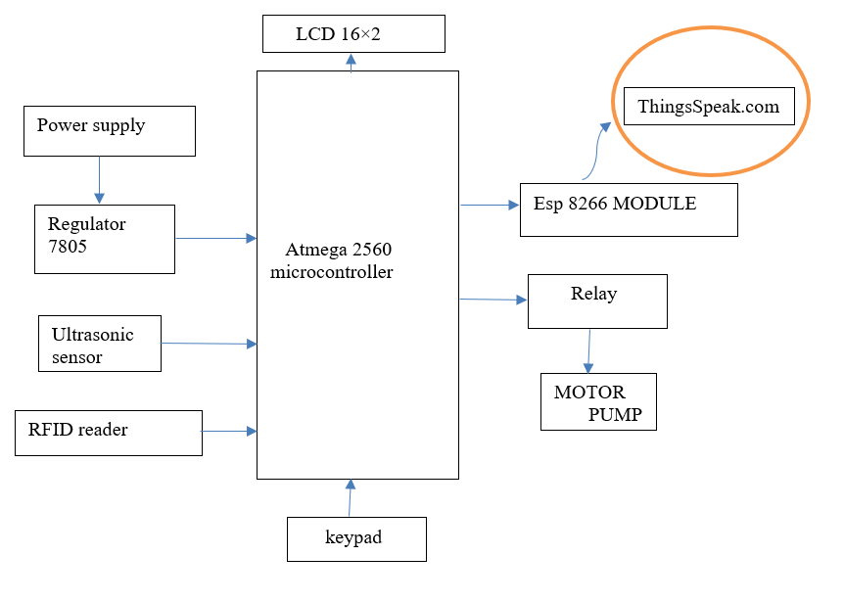
Block Diagram

Slide 9

Block Diagram Explanation
The petrol card is entered and the system reads the information.
The RFID reader reads the RFID and authenticates it.
If the RFID is valid the then the sensor level is displayed and the amount of petrol to be filled is entered.
Relay turns on the fuel dispenser and turns it off when the amount entered is recharged.

Slide 10
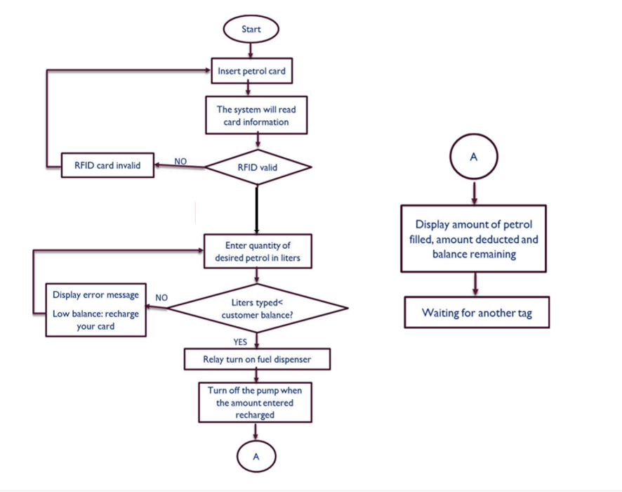

Flow Chart

Slide 11
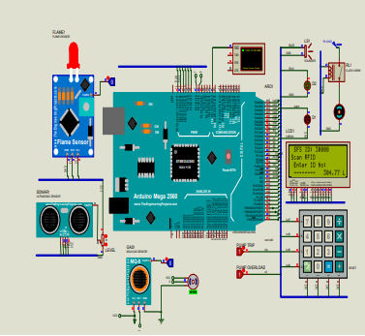
Circuit Diagram

Slide 12
Hardware & Software Required
Hardware used :
ATmega328 Microcontroller
SR04 Ultrasonic Sensor
RFID Reader
Water Pump
Relay
Keypad
ESP8266 Wi-Fi Module
LCD 16x2 Display:
Software used:
Arduino IDE (Integrated Development Environment):
Express PCB (ExpressSCH and ExpressPCB):

Slide 13

Component Specification
ESP8266 Microcontroller: Microcontroller Type: ESP8266 or a more recent model. Clock Speed: Typically operates at 80 MHz. Communication: Wi-Fi (802.11 b/g/n) for connectivity.. Input/Output Pins: Sufficient digital and analog pins.
RFID Reader and Tags:Each regular customer or user is provided with an RFID tag. These RFID tags can be in the form of cards, key fobs, stickers, or other small devices. The RFID tags are uniquely encoded with information related to the user's account, payment details, and other relevant information.
Sensors: Fire Sensor: Flame detection with a specified detection range.
Gas Leakage Detector: Gas detection (e.g., LPG, methane) with a specified sensitivity.
Spillage Sensor: Liquid spill detection.
Level Sensors: For monitoring fuel tank levels.

Slide 14
Advantages
Efficient Refueling Process:-Streamlines the fueling process by automating user and vehicle identification, making it faster and more efficient.
Convenience for Users:Eliminates the need for users to make manual payments or interact with cashiers, enhancing convenience.
Remote Monitoring:Allows remote monitoring of fueling transactions, providing petrol pump owners with real-time data and insights.

Slide 15
Disadvantages
Initial Setup Cost: Implementing the system may require a significant initial investment in RFID readers, tags, and IoT infrastructure.
Maintenance Costs: Ongoing maintenance and technical support for RFID readers and IoT components can add to the operational expenses.
Complex Implementation: Installing the system and integrating it with existing petrol pump infrastructure may be complex and time-consuming.

Slide 16
Applications
The primary application is in traditional petrol and diesel fuel stations, where it can streamline the fueling process, enhance security, and improve user experience.
The system can be adapted for EV charging stations, making it convenient for EV owners to access charging services and manage their accounts seamlessly.
Companies with vehicle fleets can use this system to efficiently track and manage fuel consumption, automate refueling, and monitor driver behavior.
Private individuals or businesses with their fueling stations can adopt this system for personalized and secure fueling.

Slide 17
Conclusion
To conclude we can say that with this project we can prevent any disastrous hazards in the station and can provide a keen control over the environmental pollution by using sensors as monitoring and control.

Slide 18
Reference
M. Compare, P. Baraldi, and E. Zio, "Challenges to IoT-enabled predictive maintenance for industry 4.0," IEEE Internet of Things Journal, vol. 7, pp. 4585-4597, 2019.
E. Aba, O. Olugboji, A. Nasir, M. Olutoye, and O. Adedipe, "Petroleum pipeline monitoring using an internet of things (IoT) platform," SN Applied Sciences, vol. 3, pp. 1-12, 2021.
H. H. Joni, A. A. Mohammed, and A. A. Shakir, "Classification of traffic accidents datasets between 2003–2017 in Iraq," Data in brief, vol. 28, p. 104902, 2020.

Slide 19
Thank You

